Slide 1
Level 2 Data Quality Academy
Data Qaulity in Tracker Programs

Slide 2
Overview
Transfering data from tracker to aggregate
Common issues with data quality in patient records.
Program rules for data quality checks
Monitoring completness through program indicators

Slide 3
Common Issues
Complex data entry with little or no workflow support
Incorrect patient data
Calculating coverage baseded upon only tracker data
Calculating completness from individual patient data

Slide 4
Program Rules
Program rules provide a way to produce dynamic behaviors in response to user input in tracker and event capture
Program rules allows you to create and control dynamic behavior of the user interface in the Tracker Capture and Event Capture apps
During data entry, program rule expressions are evaluated each time the user interface is displayed and each time a data element is changed
Notes:
More on how they are evaluated to come later on in the session

Slide 5
Program Rules
Most types of actions will take effect immediately when the user enters values in the Tracker Capture and Event Capture apps
Program rules consist of three components:
Variables
Expressions
Actions
Notes:
From here we will alternate between the slides and the DHIS2 UI and docs

Slide 6
Program Rules - Variables
Program rule variables represent attribute and data element values which will be evaluated as part of the expression -- are the first step in making rules
They create a uniform way to include data values and attribute values in expressions and actions
The program rule variable is defined as needed when creating expressions and actions
When creating your first expression, you will typically have to define one or more program rule variables, as expressions usually contain at least one data element or attribute value to be meaningful
The program rule variables are shared between all rules in your program, and by creating several rules, these will share the same library of program rule variables
Notes:
Variables are a pointer to the attribute or data element values within a tracker program.

Slide 7
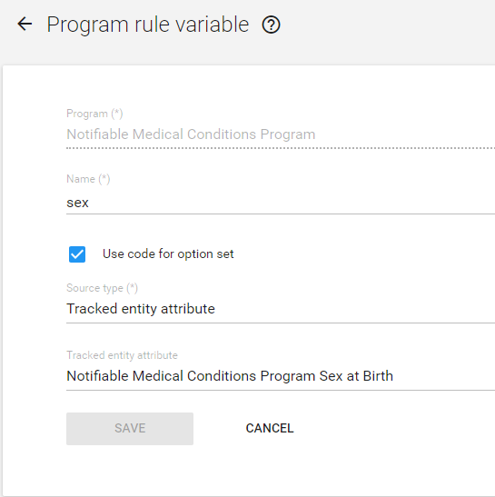
Program Rules - Variables
Example: You would like to use the attribute “Sex” in your expression. You would first define this as a program rule variable
Notes:
There are several source types that will be discussed during the demo and hands-on sessions.

Slide 8
Program Rule - Expressions
During data entry, program rule expressions are evaluated each time the user interface is displayed, and each time a data element is changed
Most types of actions will take effect immediately as the user enters values in tracker or event capture
Expressions are built from program rule variables, operators and user-defined static values

Slide 9
Program Rules - Operators
Operators are updated regularly in the docs
Notes:
Logical AND is true only when the expression on the left and right side is true. The left and right side can be yes/no, yes only or a subexpression in parenthesis.
Logical OR is true when either the expression on the left or the expression on the right side is true. The left and right side can be yes/no, yes only or a subexpression in parenthesis.
https://docs.dhis2.org/master/en/user/html/configure_program_rule.html

Slide 10
Program Rules – Examples for data quality
#{TrainedAdolescentHealthStaff} > #{FacilityStaff}
Assesses if there are more staff trained in adolescent health then staff within the entire facility
#{vaccinedoses} >= 0 && #{vaccinedoses} <= 4
Assesses if the number of vaccines doses is greater than or equal to 0 AND less than or equal to 4
(#{SampleType} == ‘Plasma’ || #{SampleType} == ‘Sputum’) && Sex == ‘MALE’
Assesses if the lab sample type is Plasma OR Sputum and the sex is male

Slide 11
Program Rules - Custom Functions
There are advanced functions that can be used in program rule expressions
Examples include:
Function | Argument | Description
d2:ceil | (number) | Rounds the input argument up to the nearest whole number.
d2:monthsBetween | (date,date) | Produces the number of full months between the first and second argument.
d2:hasValue | (sourcefield) | Evaluates to true if the argument source field contains a value, false if no value is entered
Notes:
The extensive list is available in the documentation, and some examples will be shown during the demo and exercise

Slide 12
Program Rules - Custom Function Examples
d2:ceil(#{hemoglobinValue})
If a value of 7.3 is entered for the hemoglobin value, this expression will round it up to 8
d2:monthsbetween(#{sampledate}, ‘2016-01-01’)
If the sample date is June 16, 2016, it will return a value of 5
d2:hasValue(‘vaccinedoses’)
If no value is entered this evaluates to false. If any value is entered, this will evaluate to true

Slide 13
Program Rules - Actions
Each program rule has one or more actions attached to it
These are the behaviors that are triggered in the user interface when the expression is true
Actions will be applied at once if the expression is true, and will be reverted if the expression is no longer true
There are several types of actions
Notes:
https://docs.dhis2.org/master/en/user/html/configure_program_rule.html

Slide 14
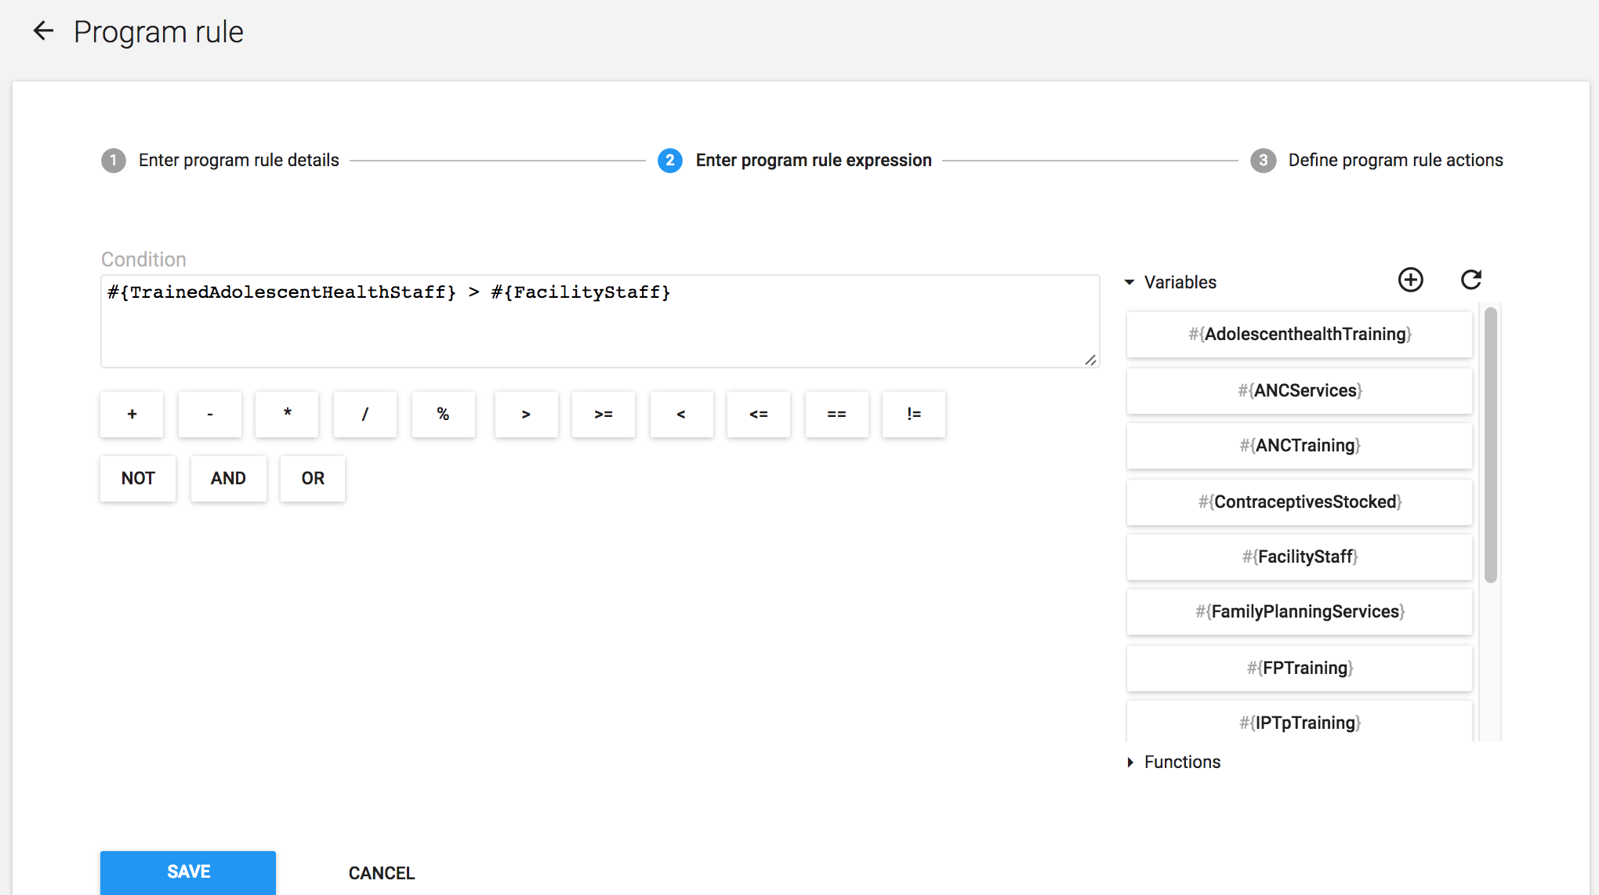
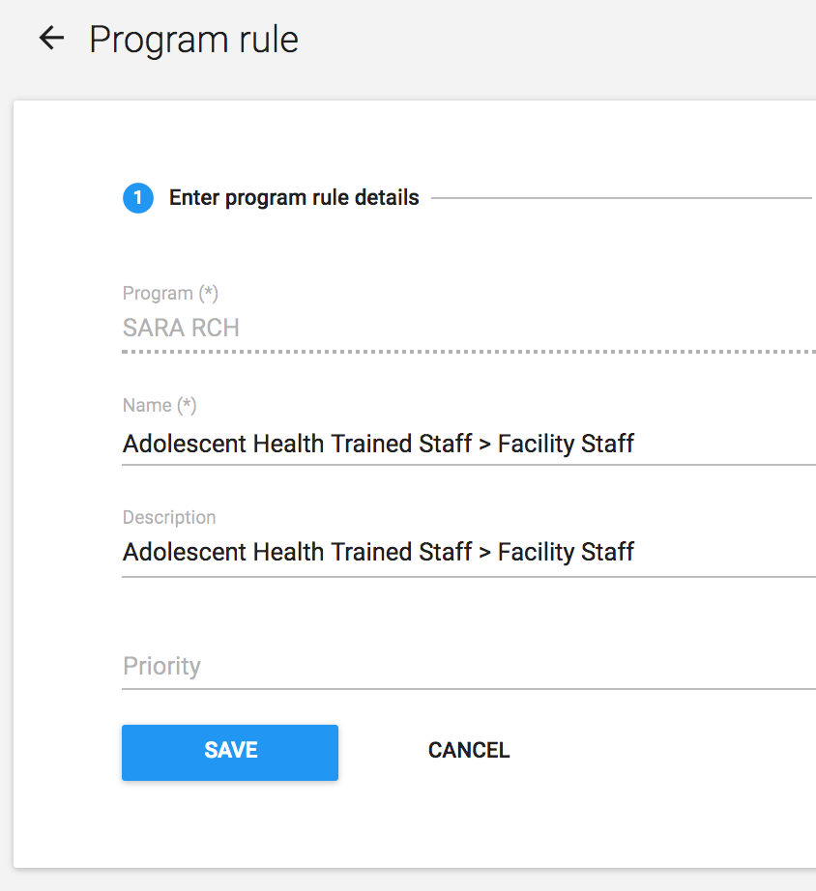
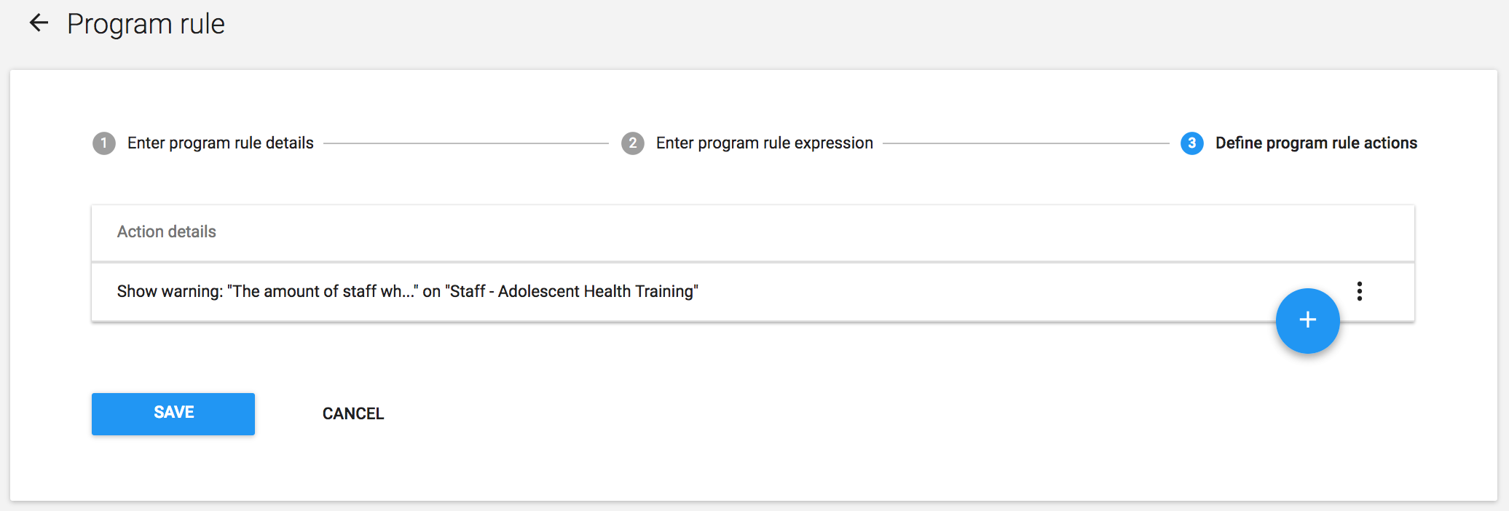
Program Rules - Summary
Notes:
Program rules are made up of source fields, expressions and actions
Source fields are the data elements or attributes in which you are evaluating expressions against
Expressions are built from source fields, operators and user-defined static values
Actions include hide field, hide section, show warning, show error, show warning on completion, show error preventing completion
These can be used to define skip logic, validation rules and other rules within the program

Slide 15
Program Rules - Steps
Conceptualise the logic of the rule you want to create
Create a source field that points to the data element/attribute which will trigger your logic
Create a new program rule
Fill in the program rule details
Select the program
Provide a name and description
Assign a priority if applicable
Enter the program rule expression
Refer the the documentation to see many examples of the items that can be used within the expression, as well as examples of expressions
Define the program rules actions
Refer to the documentation for more detail on each individual action
Clear your cache and test the rule!

Slide 16
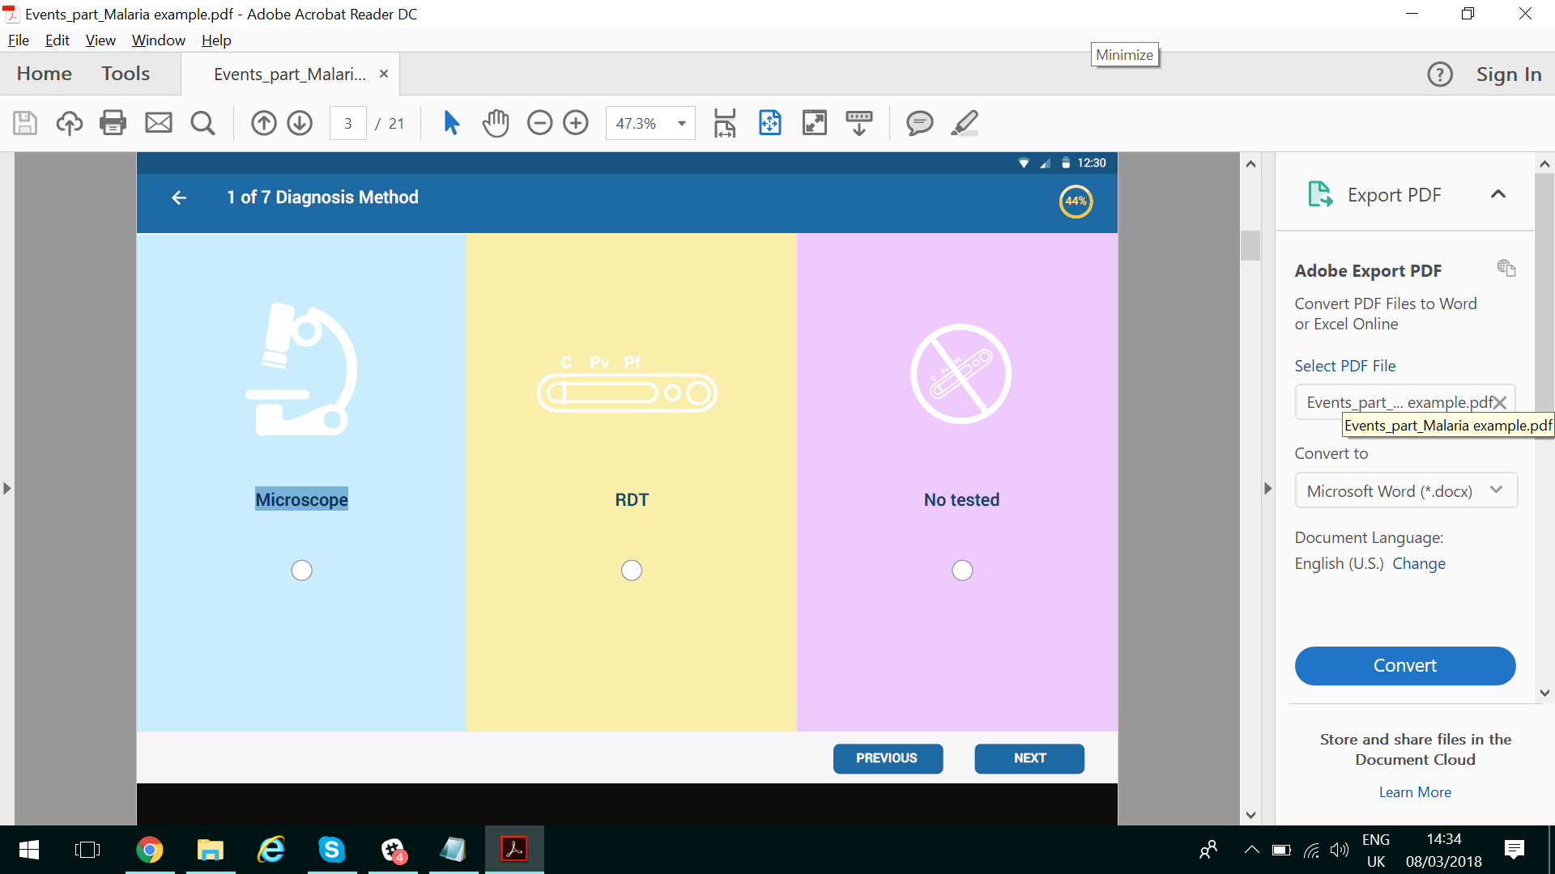
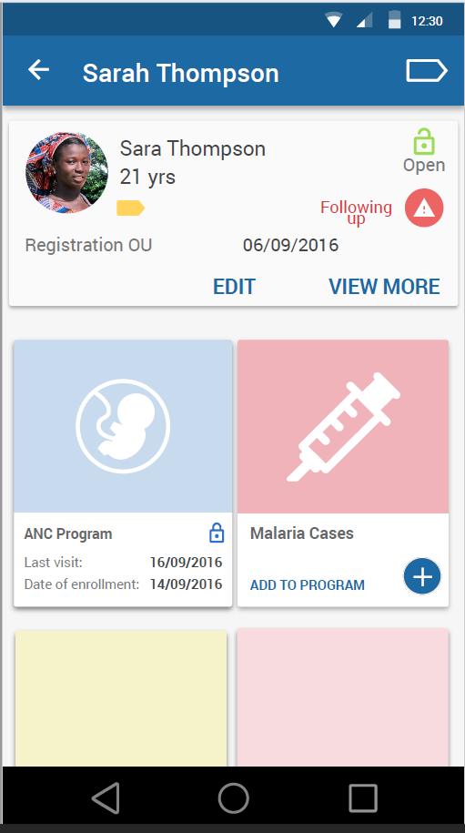
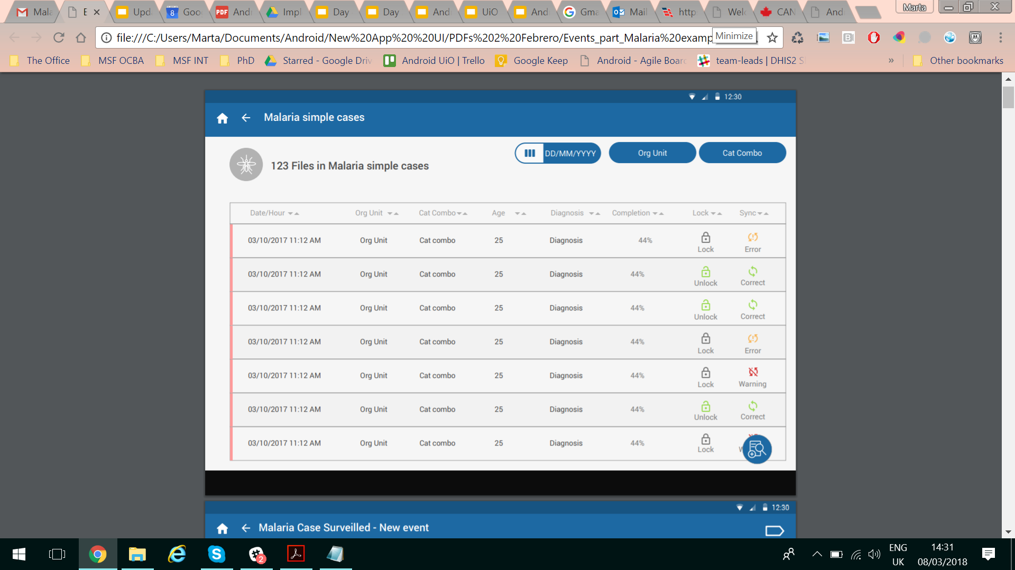
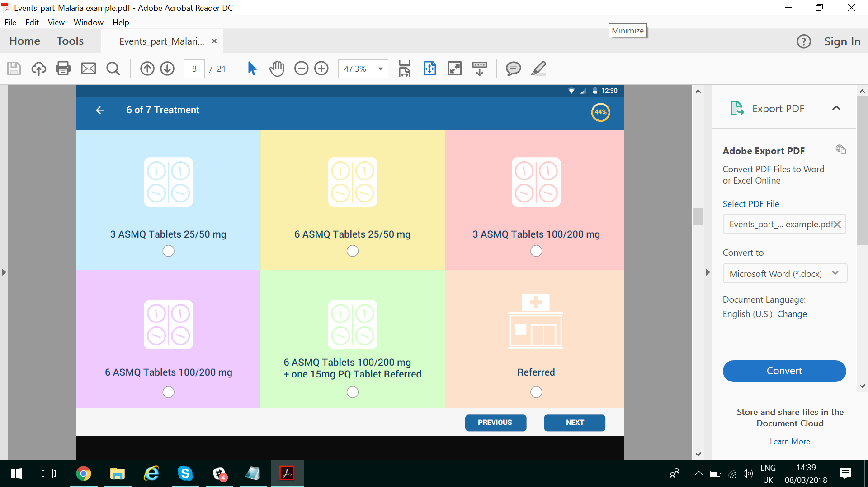
Andriod

Slide 17
Program Indicators
Program indicators allow for the creation of values based on data elements and/or attributes belonging to event or tracker programs
Program indicators use a combination of expression, aggregation type and filters in order to determine how the indicator will be evaluated

Slide 18
Example Program Indicators
Completeness of data elements in tracker programs.
Count of BCG Doses given / Total number of tracked children
Return the percentage of tracked children who have a recoded a BCG Dose
https://extranet.who.int/dhis2-dev/dhis-web-dashboard/index.html#/

Slide 19
Coverage Indicators Using Tracker Data
Indicators using both denominators (registrations and population) rather then prescribing one over the other;
we generally wouldn't recommend using only registrations alone.
Have a series of charts to then highlight the differences in coverage between the indicators calculated using both methodologies.

Slide 20
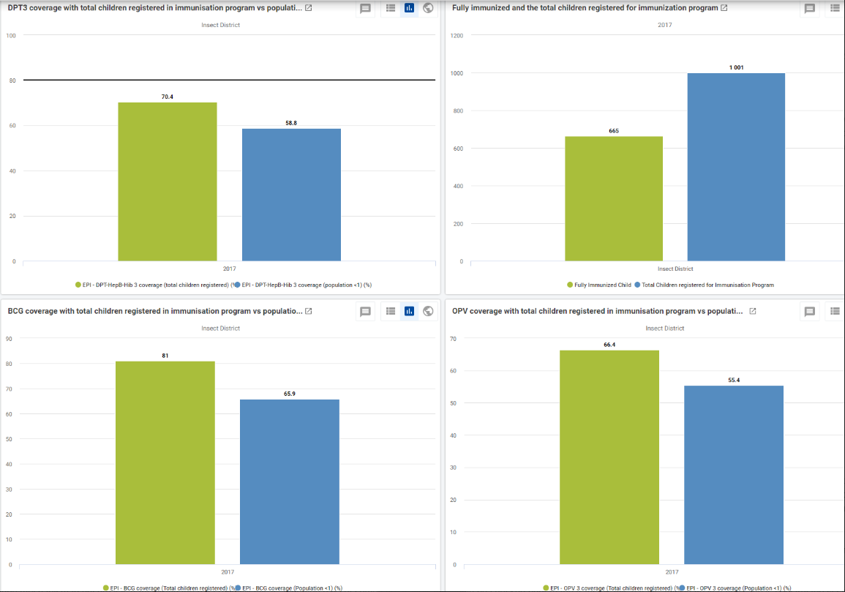

Slide 21
Monitoring aggregate data compiled from tracker to assure that errors have not occurred in data transfer
The exchange mechanism to ensure it is transferring the data
usually this is approved data is aggregated via program indicators.
This would generally be transferred to data elements in the aggregate warehouse and should match the input 1-1 from the tracker system; this can be checked after the transfer is complete

Slide 22
Required for transfering data:
1. The program indicators (or system specific process if DHIS2 is not being used) necessary to aggregate and anonymize your data
2. The data approval/review process in place to check everything before the transfer
3. The mechanism to move the data from one system to another
4. The review process in place to check after the transfer
5. Any other data quality checks you would normally apply to this data

